Slide 1


5005CEM Lecture 2a: Data Science Lifecycle
School of Computing, Mathematics and Data Science Coventry University
5005CEM Data Science 2022/23 Semester 2

Slide 2
Recap (last week)
What is Data Science?
A process of using data to understand things – tell a story
Science (apply the scientific method) – observe, explore, build models, make predictions
Collection of topics/tools (Data Scientist’s superpowers)
Analytics is “the scientific process of transforming data into insights for the purpose of making better decisions”
Descriptive/diagnostic/predictive/prescriptive analytics
“Data never sleeps” – data always being generated

Slide 3
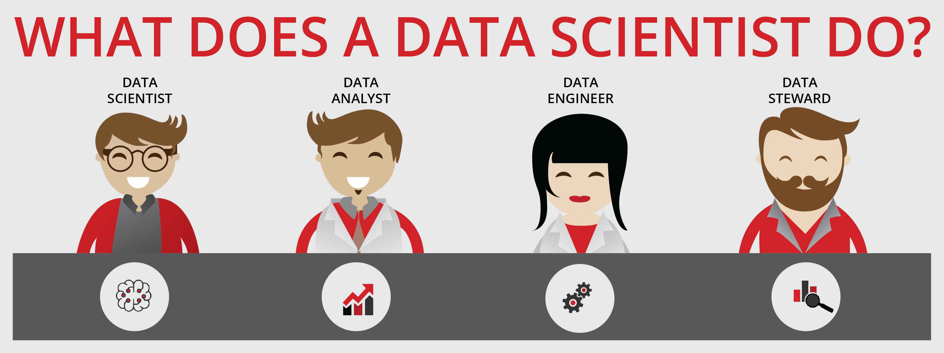
What does a Data Scientist do?
Ask questions (like a business analyst)
Get and store the data (like a data engineer)
Explore the data (like a data analyst)
Model the data (like a machine learning engineer)
Communicate results (like a data visualisation engineer)
Notes:
Article: https://medium.com/dataseries/what-does-a-data-scientist-do-a6553dc720f

Slide 4

What does a Data Scientist do?
https://www.prospects.ac.uk/job-profiles/data-scientist
“You'll extract, analyse and interpret large amounts of data from a range of sources, using algorithmic, data mining, artificial intelligence, machine learning and statistical tools, in order to make it accessible to businesses. Once you've interpreted the data you'll present your results using clear and engaging language.”
Notes:
Source: https://www.prospects.ac.uk/job-profiles/data-scientist

Slide 5
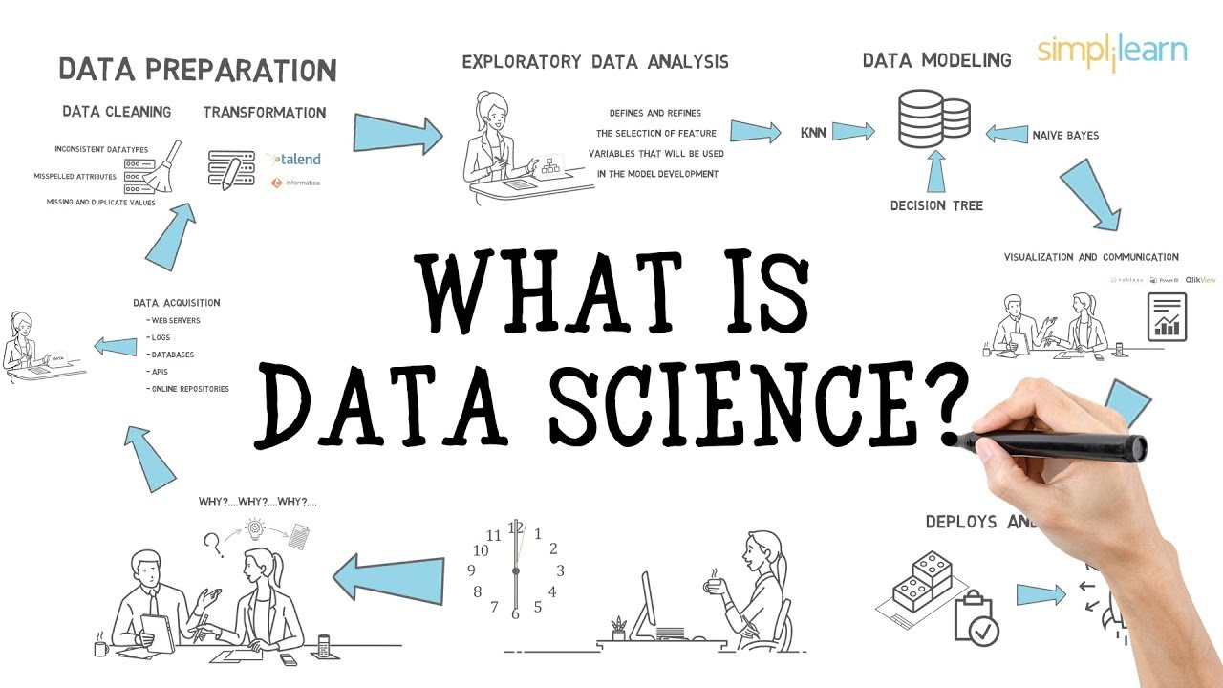
What is Data Science?
Notes:
Image: https://i.ytimg.com/vi/X3paOmcrTjQ/maxresdefault.jpg
Youtube: https://www.youtube.com/watch?v=X3paOmcrTjQ

Slide 6
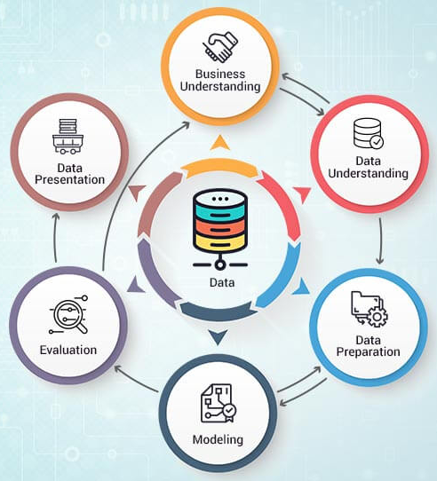
Data Science Project Lifecycle
What is involved in a successful data science project?
CRISP-DM (Cross-Industry Standard Process for Data Mining, 1996).
Notes:
CRISP-DM Image from: http://www.proglobalbusinesssolutions.com/six-steps-in-crisp-dm-the-standard-data-mining-process/

Slide 7
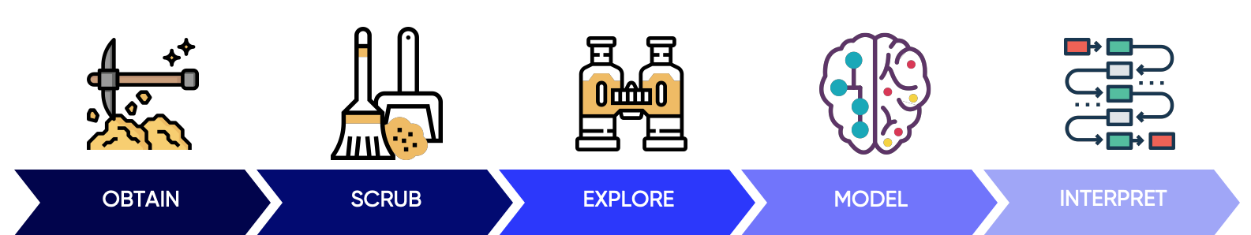
Data Science Project Lifecycle
Some common elements to many Data Science lifecycle, framework, pipeline or workflow.
OSEMN (“awesome”) pipeline model
https://machinelearningmastery.com/how-to-work-through-a-problem-like-a-data-scientist/
Notes:
OSEMN model from: https://towardsdatascience.com/5-steps-of-a-data-science-project-lifecycle-26c50372b492

Slide 8
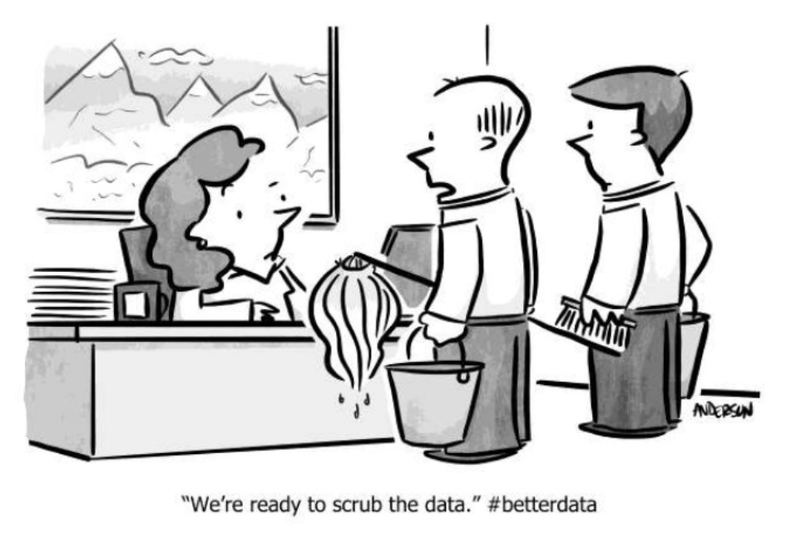
Data Science Project Lifecycle
Obtain – what data should be collected
Scrub – checking, correcting, organising, aggregating, selecting, normalising (e.g. 3NF)
Explore – graphical plots, summary statistics, identify outliers, form hypotheses
Model – explain, predict, classify
Interpret – give advice, form conclusions, follow up, critique (so what?)
Notes:
Image from: https://thelead.io/data-science/5-steps-to-a-data-science-project-lifecycle

Slide 9
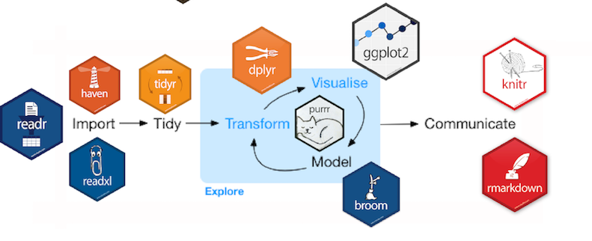
Data Science Project Lifecycle
R/tidyverse packages provide tools tailored to the common tasks in each phase of the Data Science lifecycle
Notes:
Image from: https://rworkshop.uni.lu/lectures/lecture07_plotting.html#4

Slide 10
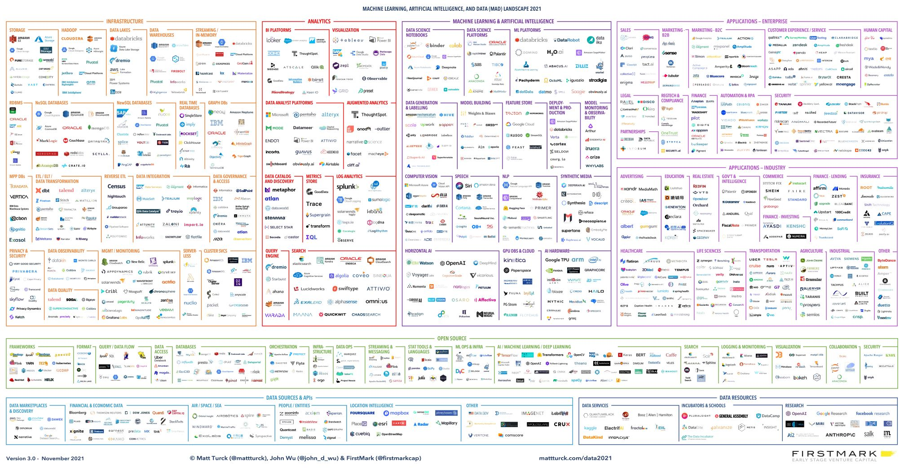
Machine Learning, AI and Data Landscape
Notes:
Article: https://mattturck.com/data2021/
Full size image: https://mattturck.wpenginepowered.com/wp-content/uploads/2021/12/2021-MAD-Landscape-v3.pdf

Slide 11
Summary
Data Scientist role involves knowledge and skills from many other roles.
Many different descriptions of a Data Science project lifecycle (with common elements).
Example: OSEMN (“awesome”) pipeline model

Slide 12
Class Discussion Question
Briefly outline how each phase of the OSEMN pipeline (data science lifecycle) could be applied to
a large online retail company (such as Amazon)
a general practice medical centre (also known as a GP surgery or local doctor)

